Slide 1
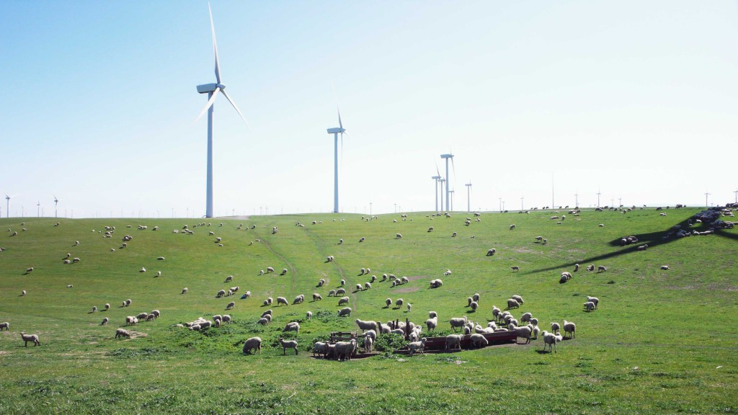
Siemens 2017 Wind Analytics Contest
Siemens Wind Power Inc.
Produce power using wind turbine
During operation, wind turbines automatically generate event information, warnings, and faults (Code)
Some of which then cause the turbine to shut down and require intervention before restart
Wind turbines are maintained by technicians, who visit the turbines when some action is needed
Stored all those information in database

Slide 2
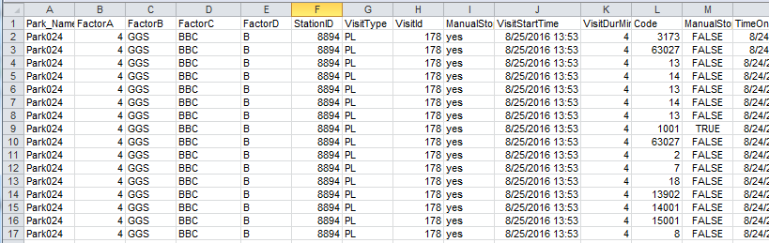
Data Outline
All variables are categorical except Visit Duration
37 Parks information
1614 Stations in all Parks
642 different Codes
7653 different visit information
Error Codes can appear in three different time points
Before the Visit Start
Within the Visit Duration
After the Visit Duration
Figure 1: Data Table

Slide 3
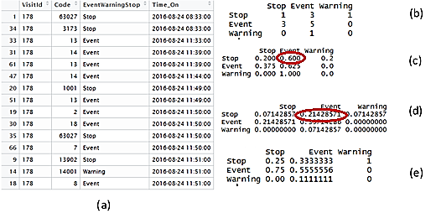
Data Construction
Different techniques has been used to construct data
Chain based count data construction
Frequency based data construction for each visit ID
Figure 2: (a) Subset of data, (b) Transition matrix based on the data (a), (c) Conditional probability matrix (For Example Probability of appearance of error code that is Event given that the present state is Stop is 0.60), (d) Probability matrix (for example, probability of appearance of consecutive error codes that are Stop and Event is 0.214), (e) Conditional Probability with respect to column factor.

Slide 4
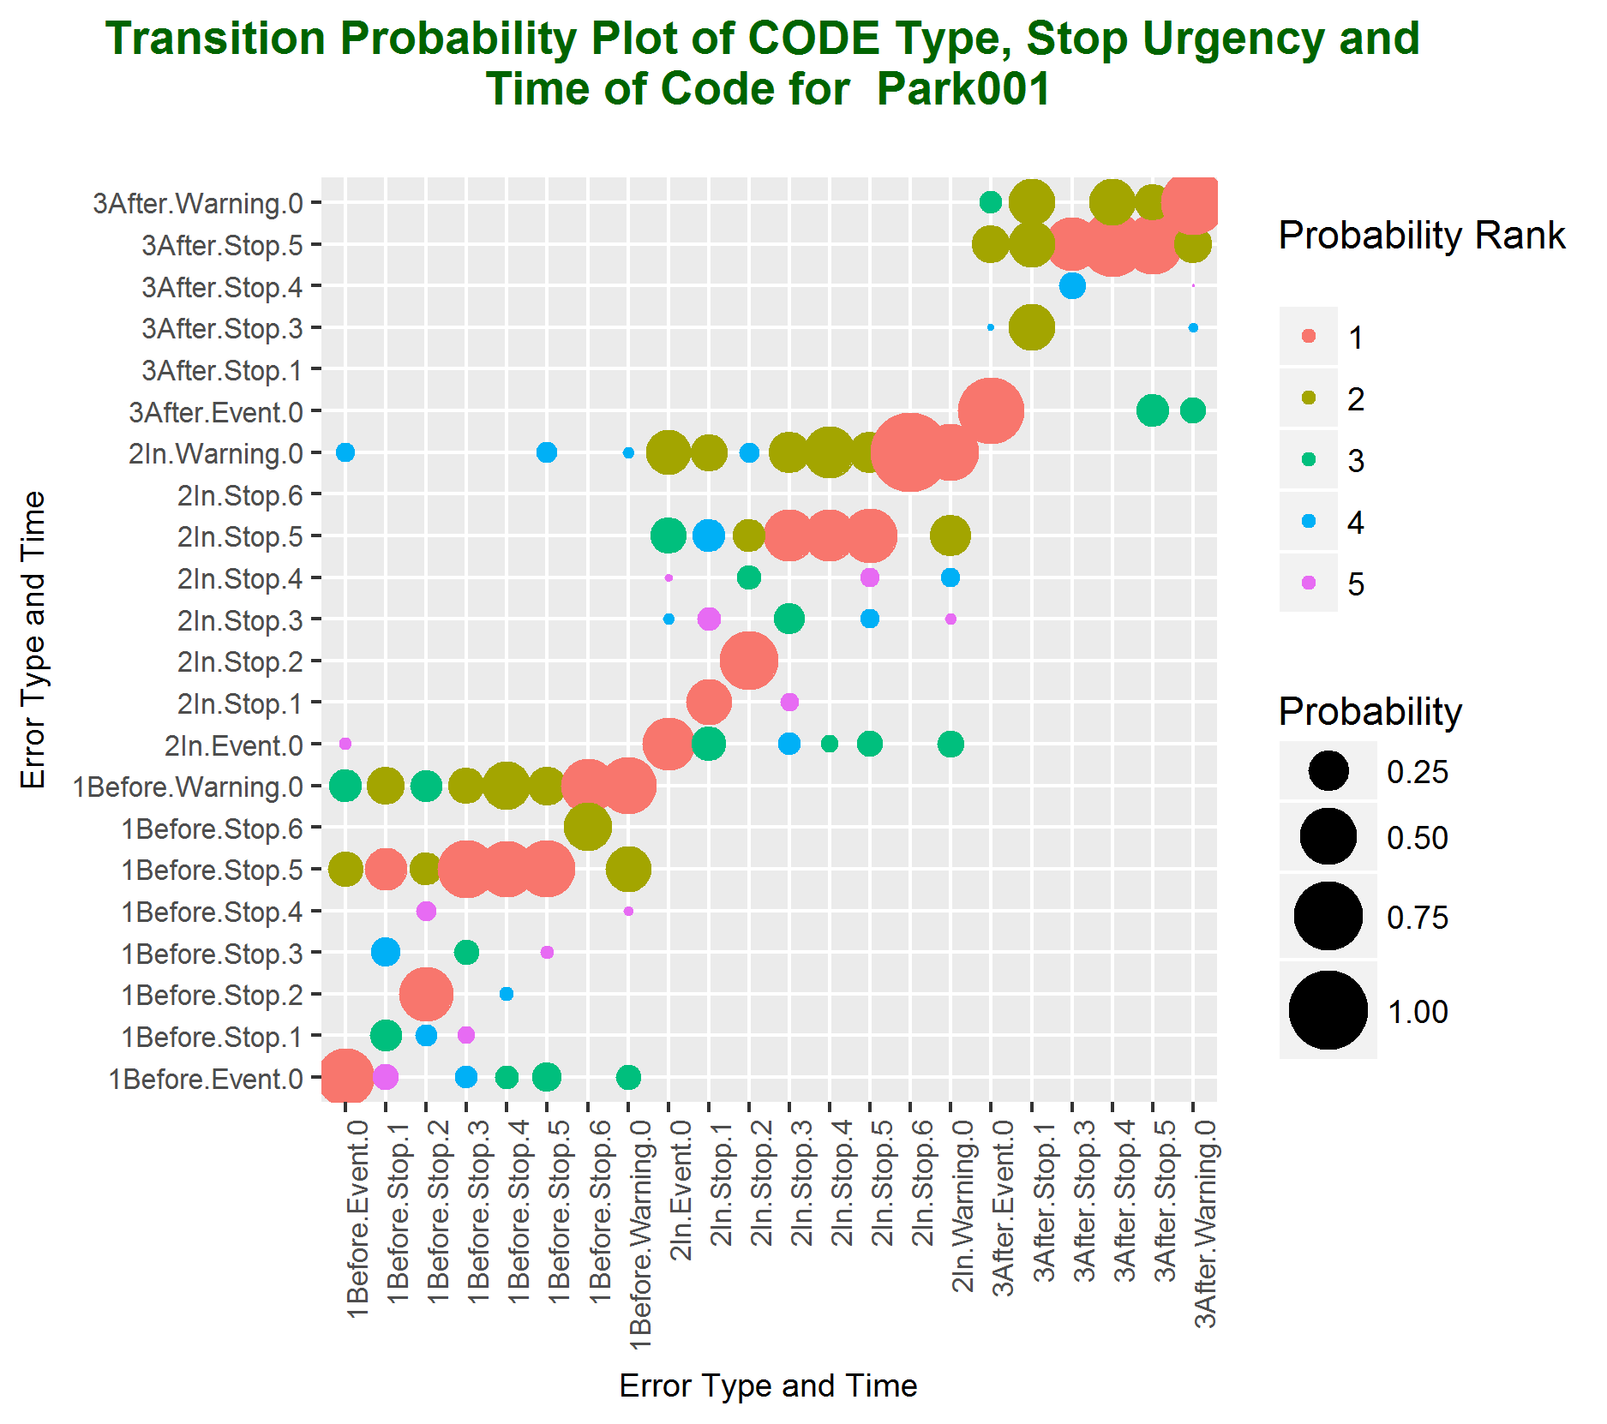
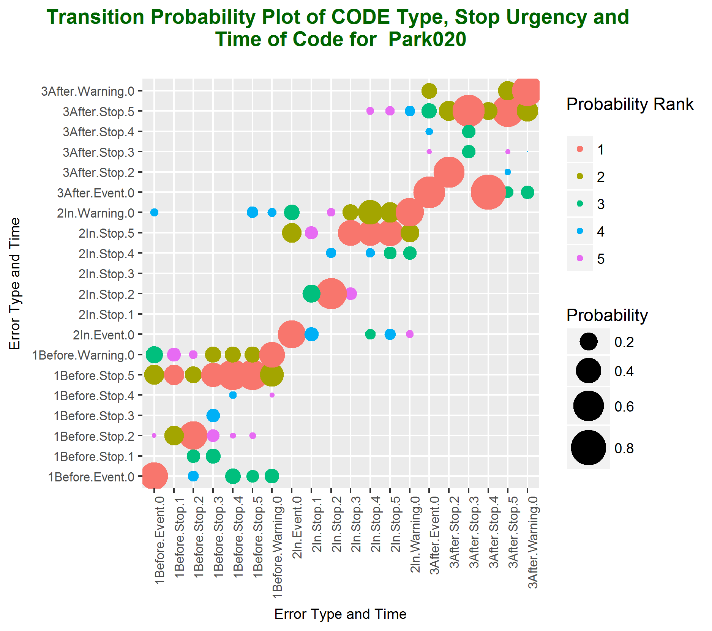
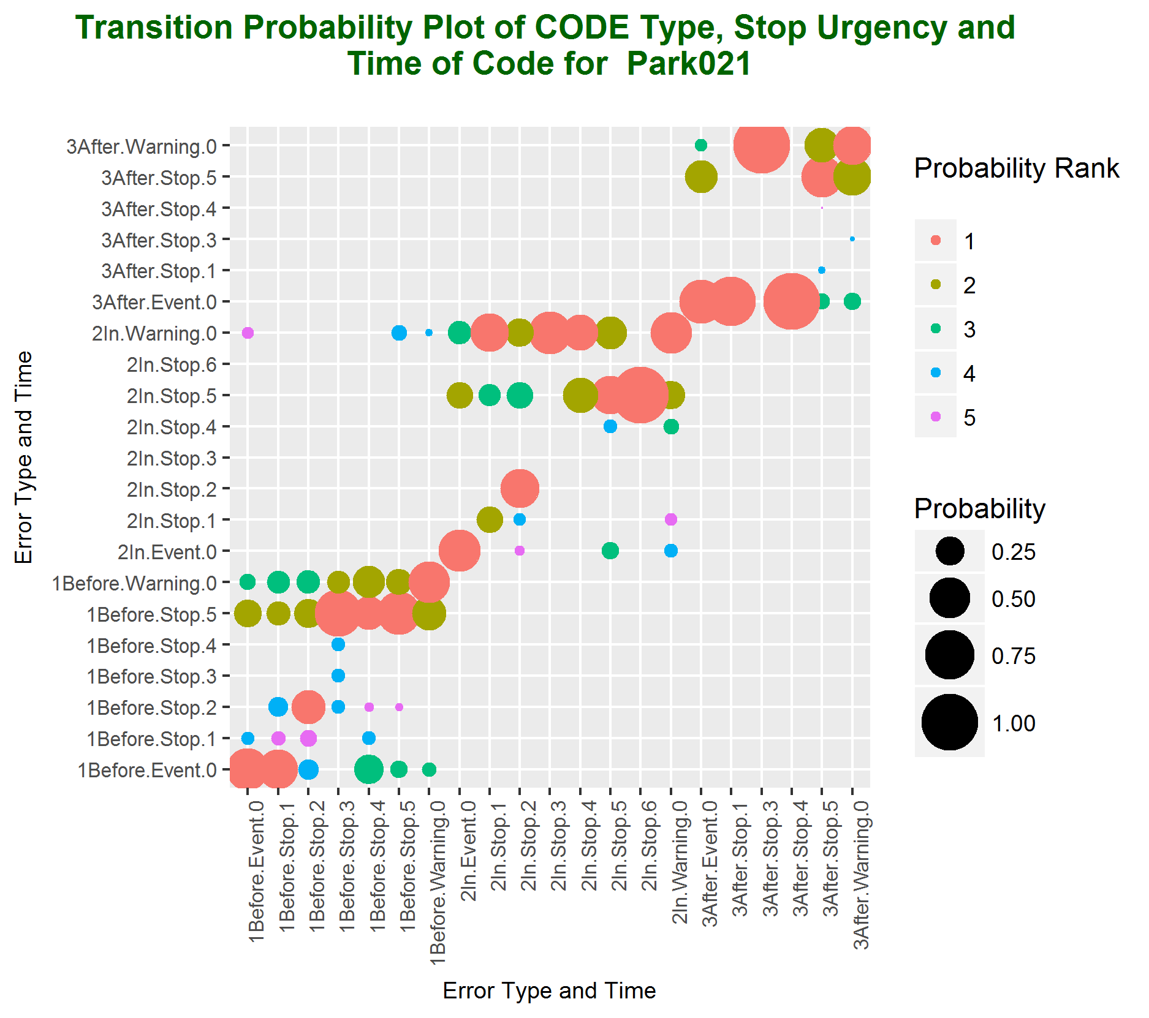
Conditional Probability Model Based on Markov Chain
For example, if there is a warning code and it appears before the visit start, the largest probability that the next code that may appear before the visit is warning code
Parks with small number of assets show different pattern than those with larger number of assets (park1→ 87, park20 → 112, park21 → 66)
(a) (b) (c)
Figure 3: Conditional Probability Plot. X-axis represents the present state and y-axis represents the future state. Color of the graph represents the rank of the probability (Rank 1 (largest probability) – Rank 5) and size of bubble represents the value of the probability of the state transitions. This plot represents the probability of appearance of type of code with urgency given the present appearance of the type of code with another urgency.

Slide 5
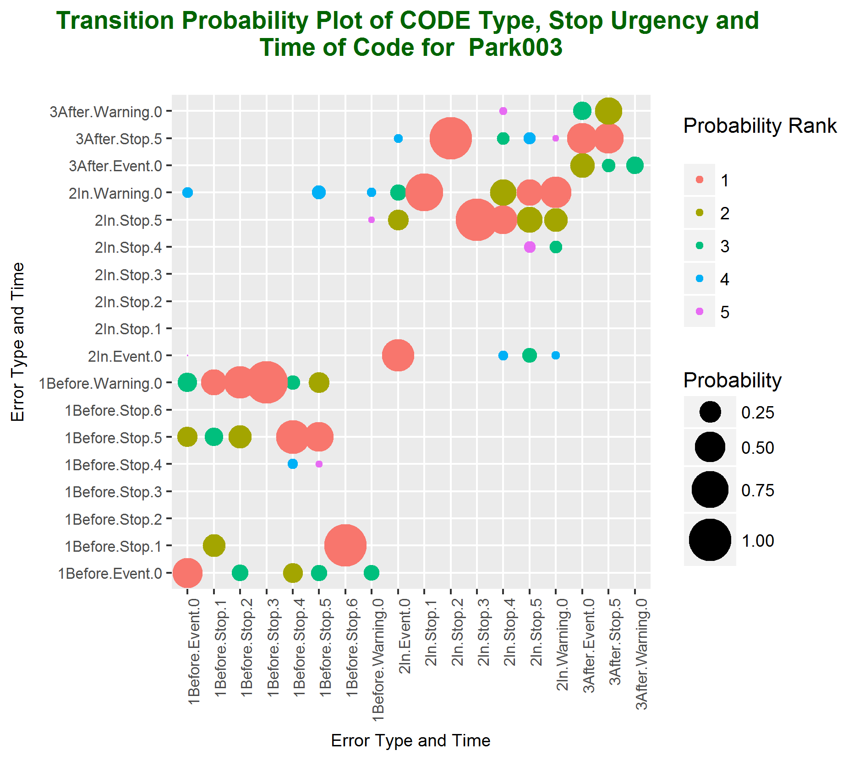
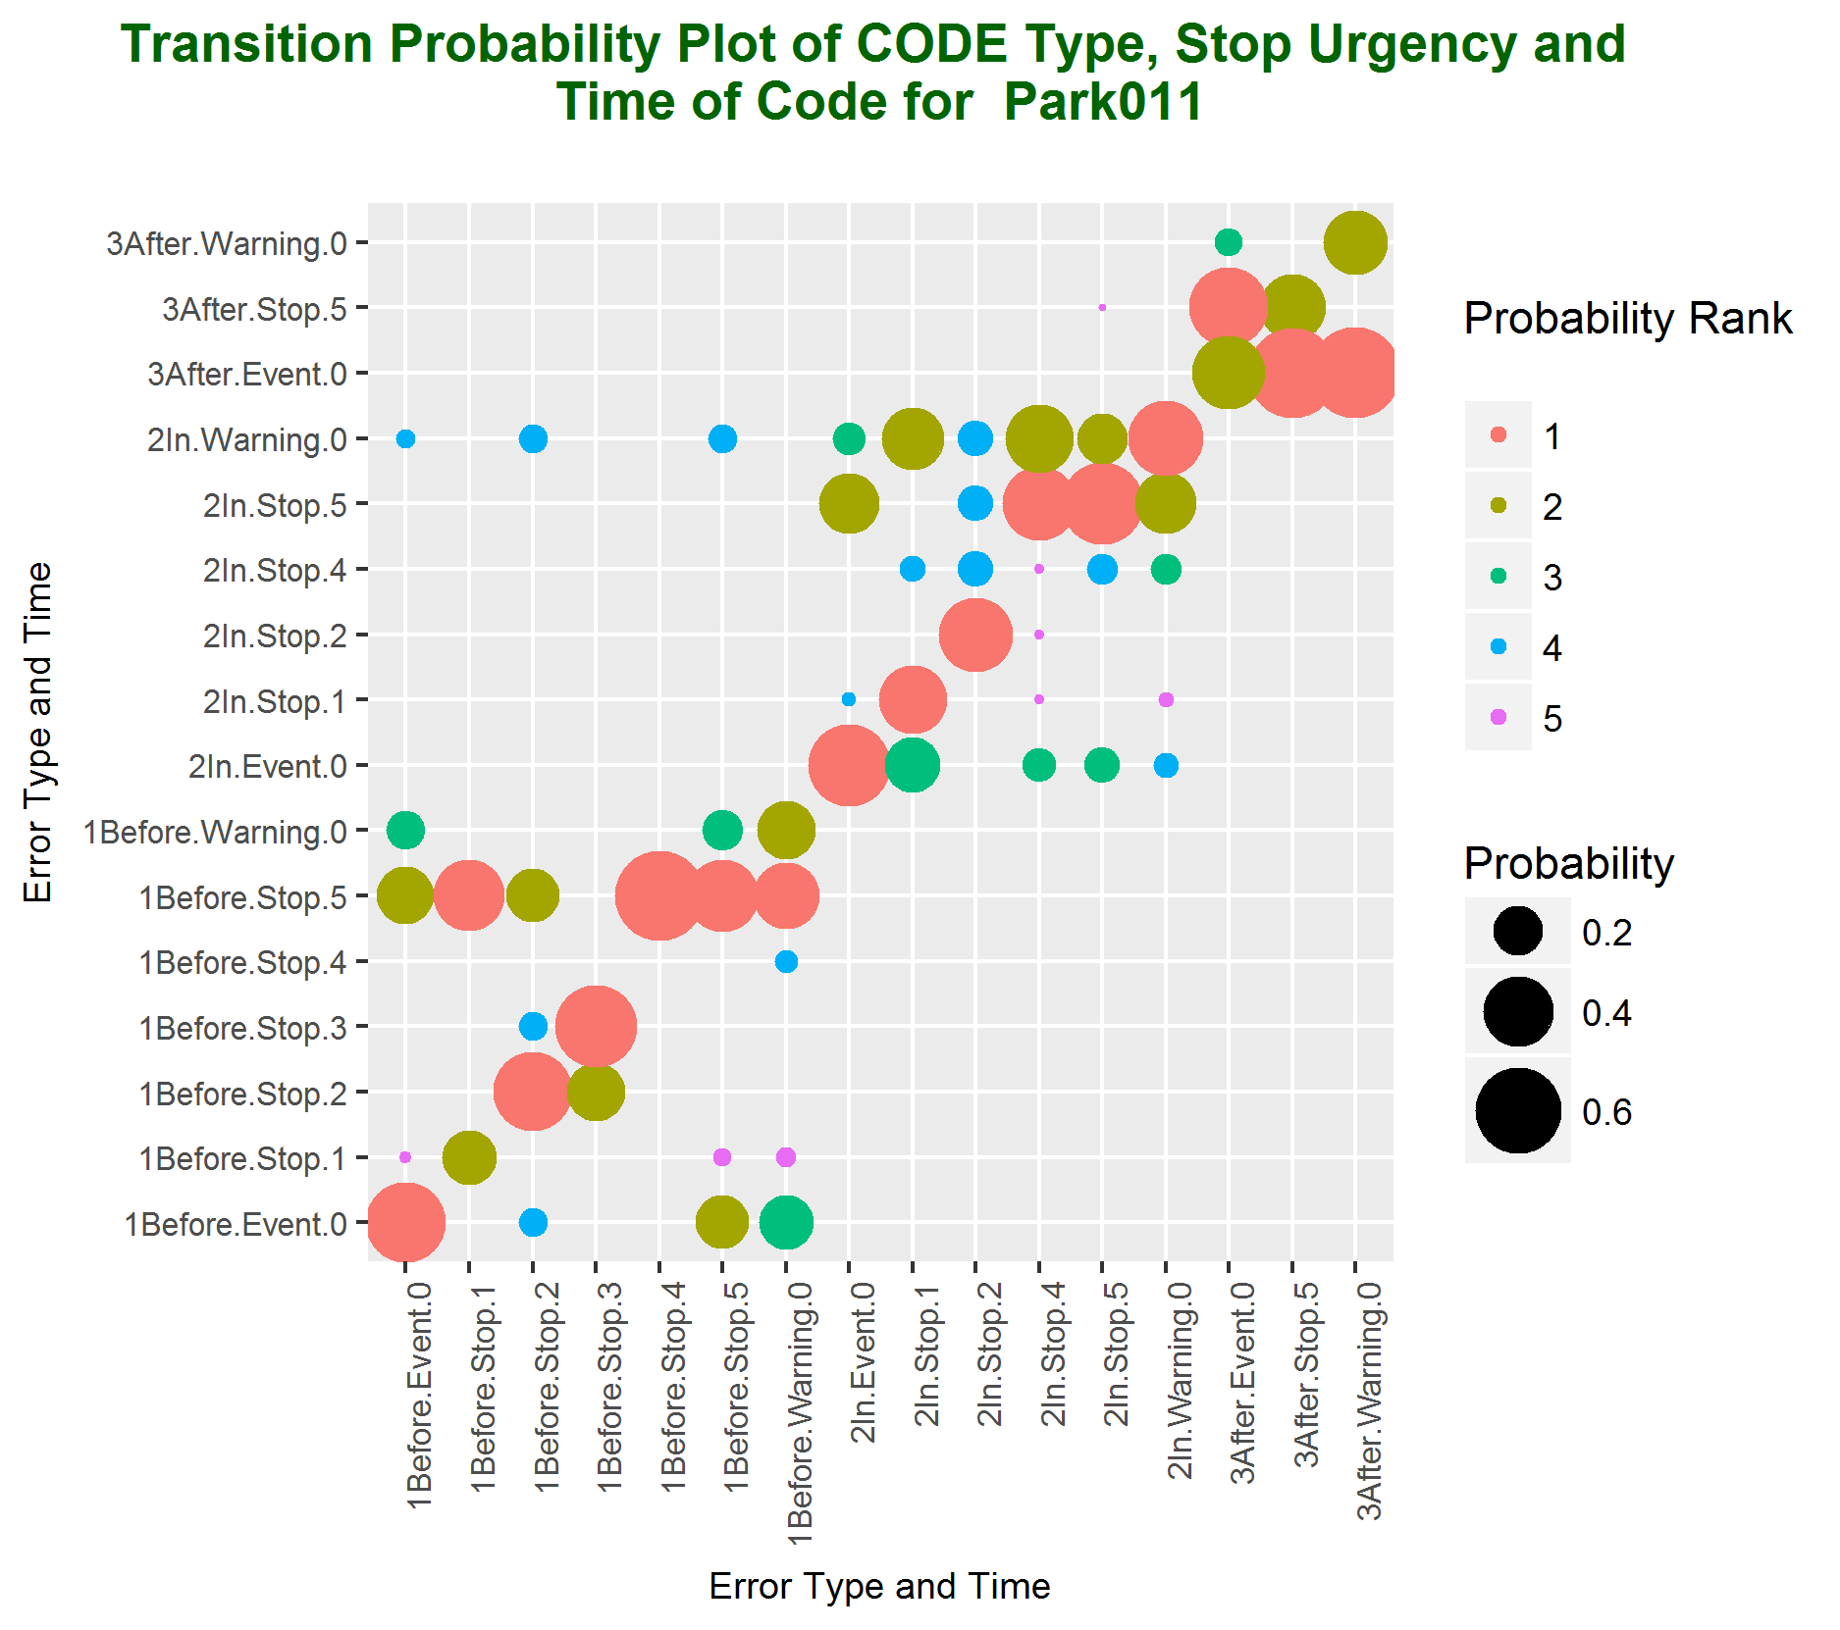
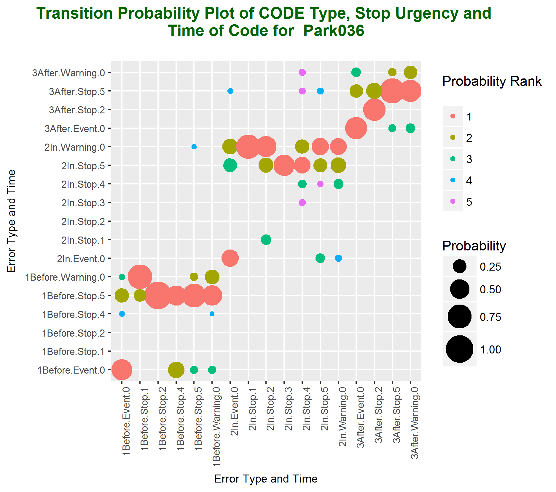
Conditional Probability Model Based on Markov Chain
Parks with small number of assets show different pattern than those with larger number of assets (park3 →21, park11 → 14 and park36 → 30)
(d) (e) (f)
Figure 4: Conditional Probability Plot. X-axis represents the present state and y-axis represents the future state. Color of the graph represents the rank of the probability (Rank 1 (largest probability) – Rank 5) and size of bubble represents the value of the probability of the state transitions. This plot represents the probability of appearance of type of code with urgency given the present appearance of the type of code with another urgency.

Slide 6
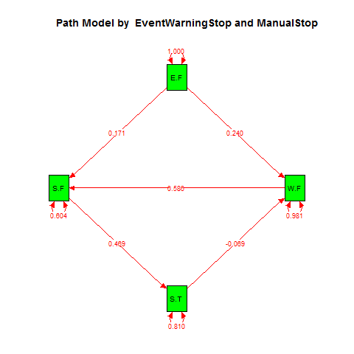
Path Model
What is path of number of different type of codes?
Is there any direct and indirect effect on type of codes that is caused by other type of codes?
Number of Stop.FALSE type of codes caused by number of Event.FALSE (0.171) and Warning.FALSE type of codes (0.586)
Event.FALSE and Warning.FALSE are positively associated with Stop.FALSE.
If the number of Warning.FALSE type of error increases, the number of Stop.FALSE type of codes will increase by 0.586 times.
Similarly, number of Warning.FALSE type of codes can be predicted by Event.False (0.24) and Stop.TRUE (-0.069).
Figure 5: Path model for the model A. Arrow indicates the direction of the variable and the value indicates coefficient of the parameter. S.F, E.F, W.F, and S.T indicate Stop.FALSE, Event.FALSE, Warning.False, and Stop.True respectively.

Slide 7
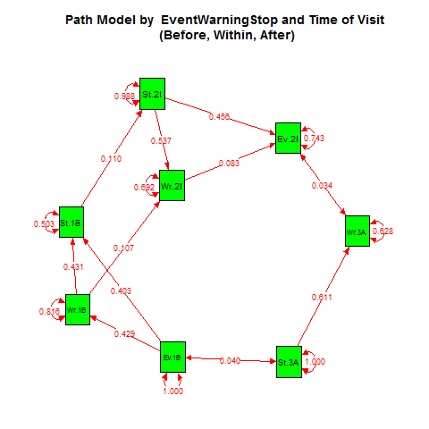
Path Model
Within Visit
Duration Path
Event_Before → Stop_Before
Event_Before → Warning_Before → Stop_Before
However, within the visit duration, the path is inverse
Stop_Within → Event_Within
Stop_Within → Warning_Within → Event_Within
After Visit
Duration Path
Before Visit
Duration Path
Figure 6: Path model for the model C. Arrow indicates the direction of the variable and the value indicates coefficient of the parameter. Ev, St, and Wr stand for Event, Stop and Warning respectfully and 1B, 2I and 3A stand for Before, Within and After visit duration.

